Slide 1
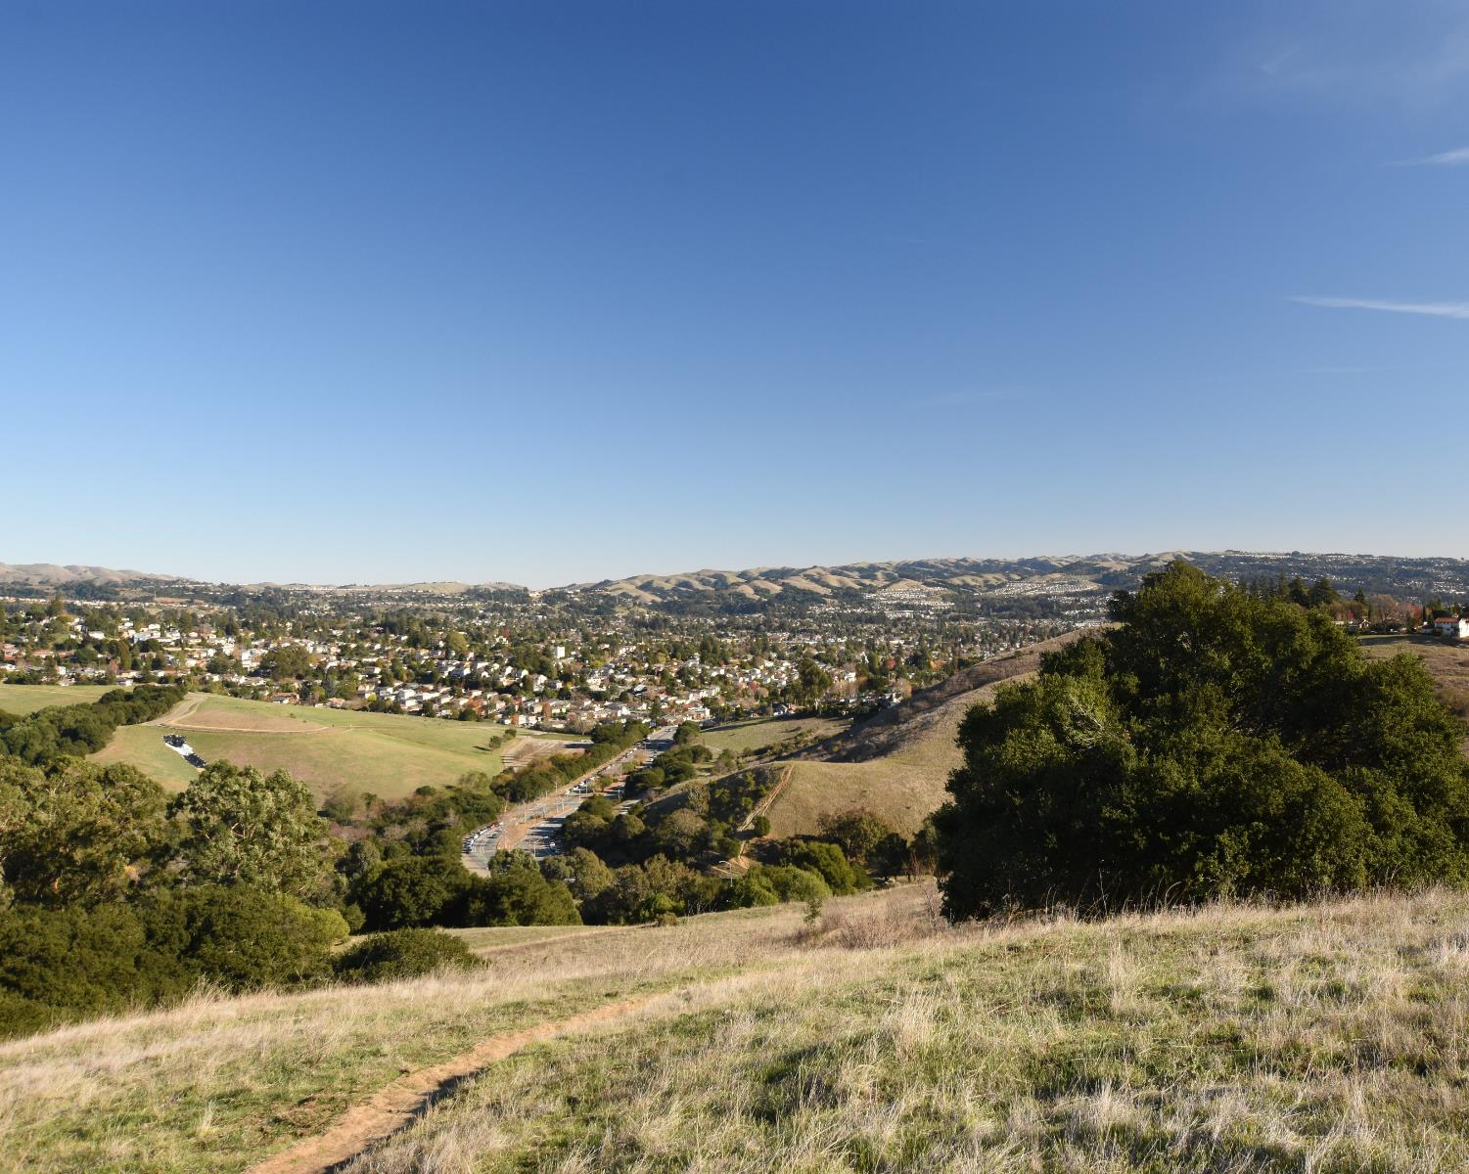

What is it? How can you participate?
Presentation Developed By:
Karin Mac Donald
Q2 Data & Research, LLC Alameda County’s Redistricting Consultant
Casey Farmer & Sandi Rivera
Community Development Agency
Alameda County
https://redistricting2021.acgov.org

Slide 2
Context
What is Redistricting?
Criteria for Redistricting
Timeline
How to Get Involved
Presentation Outline

Slide 3
Context: What is the role of the Board of Supervisors?
Alameda County has 5 Board of Supervisor districts
Voters in each district elect the County Supervisor for their district
Members of the County Board of Supervisors must live in their district to be eligible to represent it
As written in the Alameda County Charter, the Supervisors are responsible for adopting a budget (currently $3.1 billion) and overseeing 21 County departments and agencies.
The County receives millions of dollars per year from the State & Federal governments to provide social services, public health, public protection, and general government programs to its residents.
The County provides additional services to the 6 Unincorporated Areas which do not have a City government: Ashland, Castro Valley, Cherryland, Fairview, San Lorenzo, & Sunol. (Example: public works)
Notes:
Example for Bullet #2: This means that if I live in District 2, I only get to vote for the candidates running for only District 2 Supervisor, not District 1 or 3

Slide 4



What is Redistricting?
Redistricting is the process of adjusting the existing district boundaries & occurs every 10 years after the release of new Census population numbers
Since areas grow and change over time, redistricting is the opportunity to reevaluate the districts:
equalize the population in each district
ensure districts comply with redistricting criteria
The Board of Supervisors is responsible for the adoption of the new districts. The new map requires a two-thirds vote.

Slide 5
New State Law for Redistricting Process
FAIR MAPS Act became law in October 2019 and stands for: “Fair And Inclusive Redistricting for Municipalities And Political Subdivisions”
Requirements of the new law (for cities and counties):
Website
Public hearings (at least 4)
Post information with advance notice
Make the process publicly accessible (including applicable language translations and interpretation)
Accept public input in multiple forms
Outreach to local organizations, local media & ethnic media
Goal: to make Redistricting more
transparent & accessible!

Slide 6
What are the criteria to draw Districts?
Criteria Ranked in Order of Priority (“to the extent practicable”)
Each district must have equal population
Comply with Federal Voting Rights Act
.Contiguity
Minimize divisions of neighborhoods & Communities of Interest
Minimize divisions of Cities and Census Designated Places
Boundaries should be easily identifiable and understandable
Compactness:
Do not favor or discriminate against political parties
Total Population
5 Districts
Protect racial & language minorities
all parts of the district must be adjacent
COI’s cannot include political parties, candidates or incumbents
CDP = unincorporated communities
Don’t bypass an area in favor of population further away.
If it doesn’t conflict with preceding criteria
No politics!
Notes:
1. Total Population divided by 5; Equal population +/- 5%
2. The gist of the FVRA: Prohibits practices that have the purpose or effect of discriminating on the basis of race or language minority status.
3. Electoral systems can limit the “ability to elect a candidate of choice” by a protected class of voters in various ways (or dilute their vote)
4. More on Communities of interest in the next slides
6. District lines should be straightforward
Respect roads, natural features
Lines need to make geographical sense
7 = Don’t bypass nearby areas of population in favor of more distant populations

Slide 7
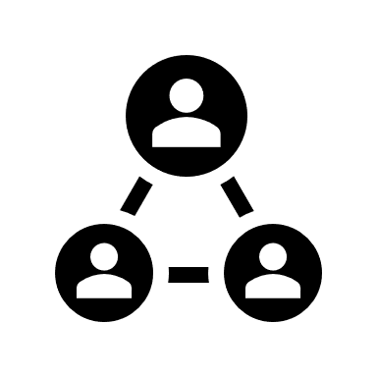
What is a Community of Interest? (COI)
A geographic area comprised of residents who share similar interests
Economic interests:
Current situation — common employment or economic opportunities (or lack thereof).
Goals — expanding opportunities, development, bringing in jobs & businesses, etc.
Social interests:
Current — schools, culture, transportation, parks
Goals — improving recreation opportunities or public safety, etc.
Describe what defines your COI:
What bonds your community?
What is your mission or commonality?
What are your common goals?
What is different outside of the boundaries of your COI?
Notes:
It is up to those who live in or work with a community to identify and establish the interests that unite it.

Slide 8

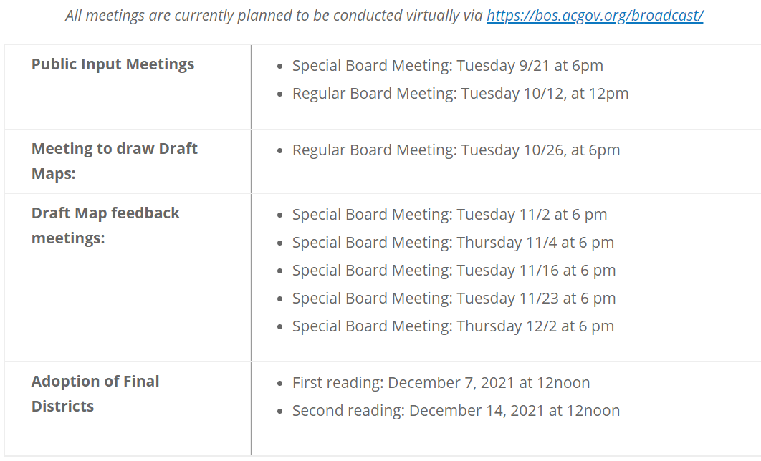
Alameda County Redistricting Timeline

Slide 9
Alameda County Redistricting Timeline
All meetings are currently planned to be conducted virtually via https://bos.acgov.org/broadcast/
Public Input Meetings | Tuesday 9/21 at 6pm Tuesday 10/12 at 12pm
Meetings to Draw Draft Maps | Tuesday 10/26 at 6pm
Draft Map Feedback Meetings | Tuesday 11/2 at 6pm Tuesday 11/4 at 6pm Tuesday 11/16 at 6pm Tuesday 11/23 at 6pm Tuesday 12/2 at 6pm
Adoption of Final Districts | First Reading: Tuesday, December 7 at 12noon Second Reading: Tuesday, December 14 at 12noon

Slide 10
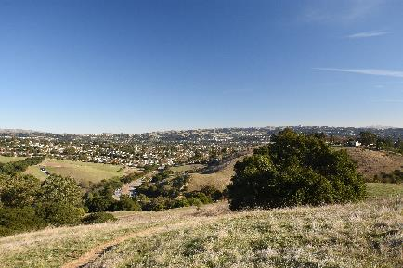




Why should you participate?
To make sure we know about your Community of Interest.
To give your community a voice and make sure it has equal access to the political process.
To encourage citizens to register, vote, and remain politically engaged.
To help shape a redistricting plan that provides communities a meaningful opportunity to elect candidates who represent their interests on issues that are important to their lives.

Slide 11
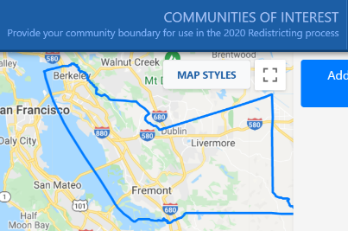
Get Involved: Shape your future!
http://www.districtelections.ci.antioch.ca.us/
What information are we looking for?
What is your Community of Interest? (Tip: Review Slide 7)
Where is your COI? Be specific in your geography
How to submit your input?
Method | Details
Draw | Submit a Community of Interest (through our site) Create a district map for the Board to consider (program available late September 2021)
Speak | During public comment at any Redistricting Hearing (Slide 8)
Email | redistricting@acgov.org or “Contact Us” on our website
Mail | Community Development Agency, Attn: Sandi Rivera 224 W. Winton Ave, Room 110 Hayward, CA 94544
Phone | (510) 670.5333

Slide 12
THANK YOU
FOR PARTICIPATING!!!
https://redistricting2021.acgov.org

