Slide 1
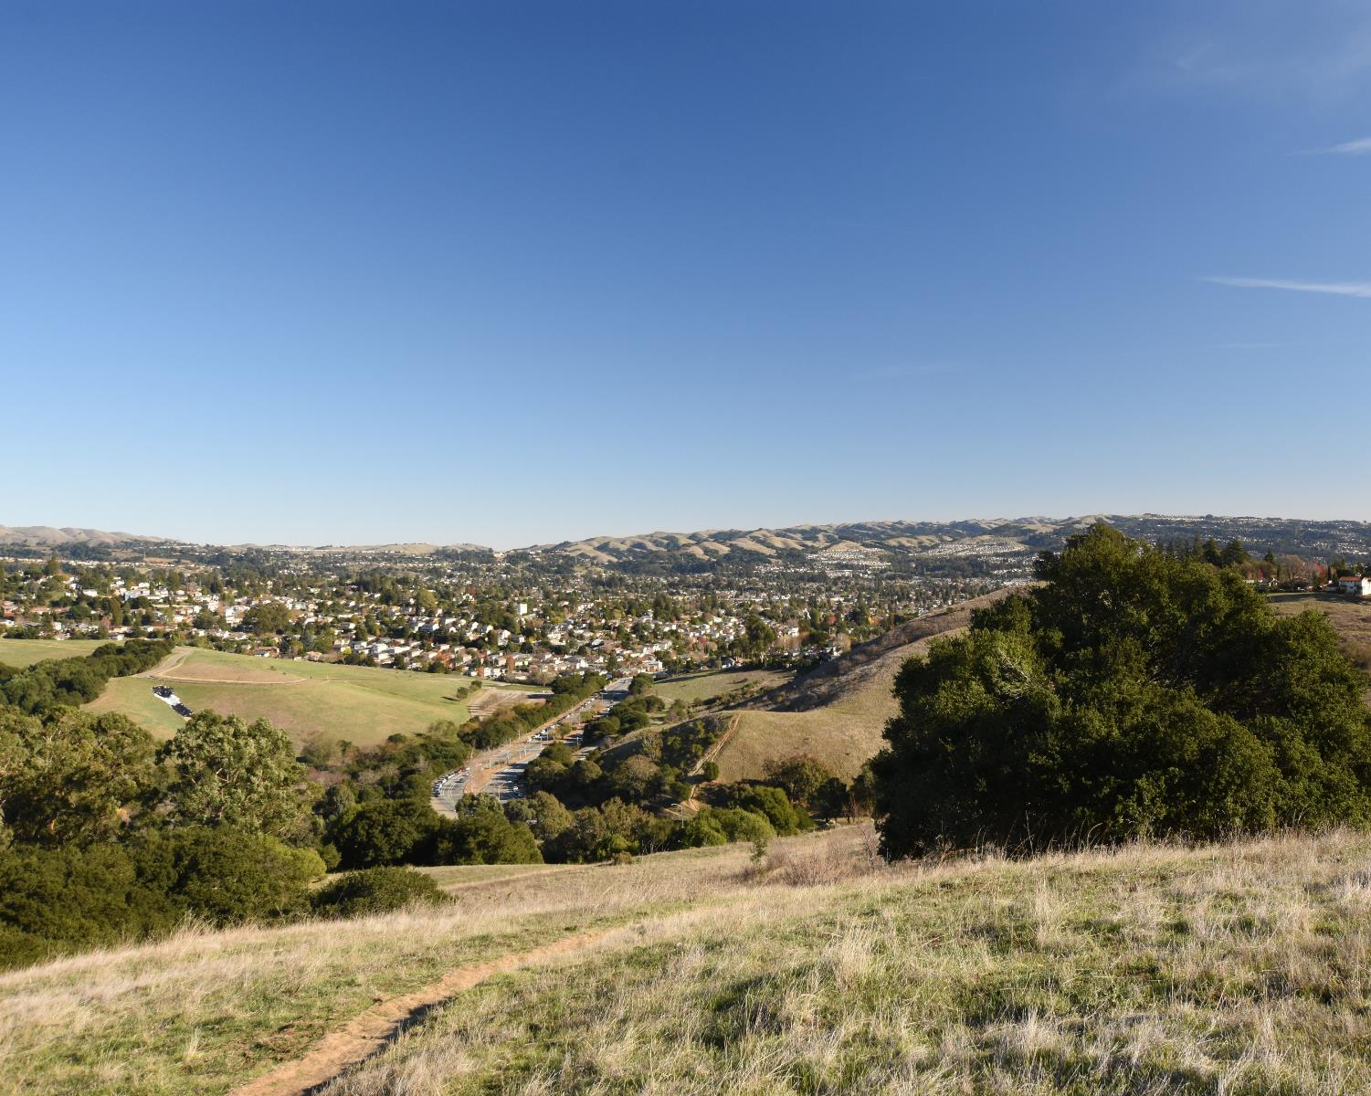

Public Hearing – October 12, 2021
Karin Mac Donald & Jane Hood
Q2 Data & Research, LLC Alameda County Redistricting Consultants
Chris Bazar, Casey Farmer & Sandi Rivera
Community Development Agency
Alameda County
https://redistricting2021.acgov.org

Slide 2
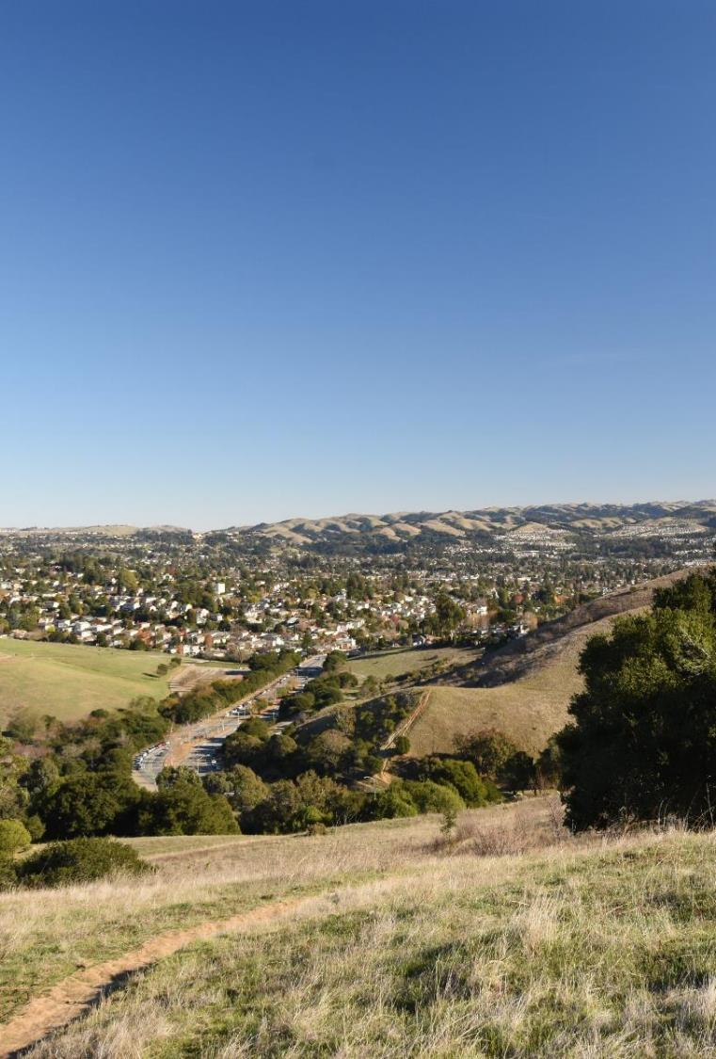
Outline
Outreach Activities
Community of Interest (COI) Overview
CA Adjusted Census Data
Mapping Criteria
Board Receive Public Comments
Provide direction to consultant and staff on scenarios for the next Board meeting

Slide 3
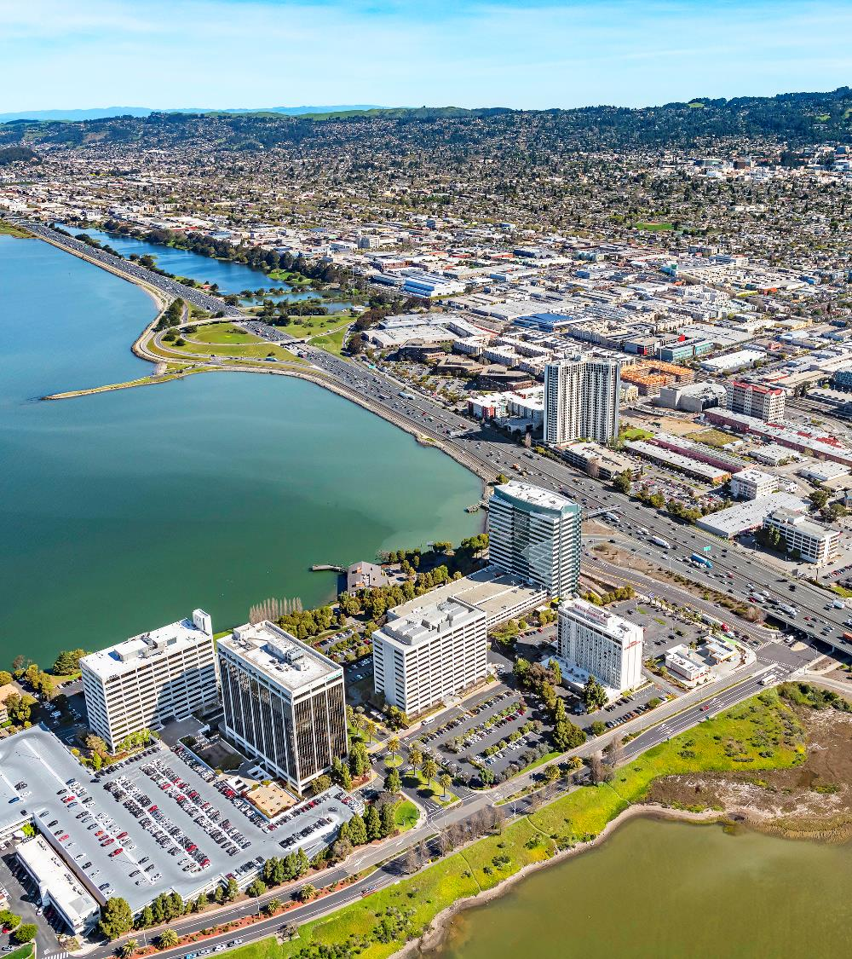
Outreach Activities
Presentation at Alameda County Mayor's Conference
Announcement at all 14 City Council Meetings (in progress)
Local and Ethnic Media Outreach
Educating "Trusted Messengers" about redistricting process and how to engage

Slide 4
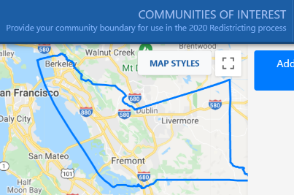
Public Input To Date
Method of Participation | Inputs as of 10/8/2021
“Community of Interest” Online Tool Submissions | 67
Written comments: Emails, comments on the webpage, or mailed in | 50
Proposed public maps Online mapping program and redistricting data made available October 11 | In Progress
Notes:
Casey to note outreach efforts. Summarize public input later.

Slide 5
What is a Community of Interest “COI”?
A geographic area comprised of residents who share similar interests
Economic interests:
Current situation — common employment or economic opportunities (or lack thereof).
Goals — expanding opportunities, development, bringing in jobs & businesses, etc.
Social interests:
Current — schools, culture, transportation, parks
Goals — improving recreation opportunities or public safety, etc.

Slide 6

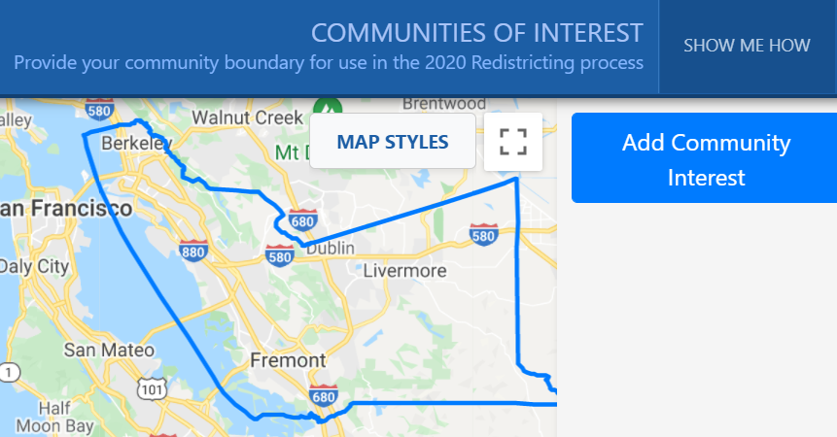
What is a Community of Interest “COI”?
Tell us about your community.
What are your shared interests?
What brings you together?
What is important to your community?
Are there nearby areas you want to be in a district with? Or nearby areas you don't want to be in a district with? Why or why not?

Slide 7

COI Submittals Overview
Change to map presentation

Slide 8
2020 Census Data – CA Adjusted PL 94-171
 | POPULATION |  |  | Percent Change
 | 2020 | 2010 | Change
Alameda County | 1,683,468 | 1,510,271 | 173,197 | 11.5%
Alameda | 78,351 | 73,812 | 4,539 | 6.1%
Albany | 20,275 | 18,539 | 1,736 | 9.4%
Berkeley | 124,433 | 112,580 | 11,853 | 10.5%
Dublin | 71,468 | 46,036 | 25,432 | 55.2%
Emeryville | 12,911 | 10,080 | 2,831 | 28.1%
Fremont | 230,649 | 214,089 | 16,560 | 7.7%
Hayward | 163,172 | 144,186 | 18,986 | 13.2%
Livermore | 88,006 | 80,968 | 7,038 | 8.7%
Newark | 47,570 | 42,573 | 4,997 | 11.7%
Oakland | 441,891 | 390,724 | 51,167 | 13.1%
Piedmont | 11,274 | 10,667 | 607 | 5.7%
Pleasanton | 79,894 | 70,285 | 9,609 | 13.7%
San Leandro | 91,103 | 84,950 | 6,153 | 7.2%
Union City | 70,218 | 69,516 | 702 | 1.0%
Unincorporated | 152,253 | 141,266 | 10,987 | 7.8%
Source: Census 2010, Redistricting Data (Public Law 94-171) Summary File
Census 2020, CA Adjusted Redistricting Data (Public Law 94-171) Summary File (9/27/2021)

Slide 9
Population of Existing Supervisorial Districts
Population Change 2010-2020
 |  |  |  | Percent Change
 | 2020 | 2010 | Change
Alameda County | 1,683,468 | 1,510,271 | 173,197 | 11.5%
District 1 | 341,012 | 295,846 | 45,166 | 15.3%
District 2 | 333,558 | 305,652 | 27,906 | 9.1%
District 3 | 327,773 | 301,349 | 26,424 | 8.8%
District 4 | 344,963 | 310,027 | 34,936 | 11.3%
District 5 | 336,162 | 297,397 | 38,765 | 13.0%
Source: Census 2010, Redistricting Data (Public Law 94-171) Summary File
Census 2020, CA Adjusted Redistricting Data (Public Law 94-171) Summary File (9/27/2021)

Slide 10
Population of Existing Supervisorial Districts
Supervisorial Redistricting 2021
District | Population | Deviation from Ideal Population | % Deviation
1 | 341,012 | 4,318 | 1.28%
2 | 333,558 | (3,136) | -0.93%
3 | 327,773 | (8,921) | -2.65%
4 | 344,963 | 8,269 | 2.46%
5 | 336,162 | (532) | -0.16%
Total Population | 1,683,468
Ideal Population | 336,693.6
Source: Census 2020, CA Adjusted Redistricting Data (Public Law 94-171) Summary File (9/27/2021)
Q2 Data & Research
Community Development Agency

Slide 11
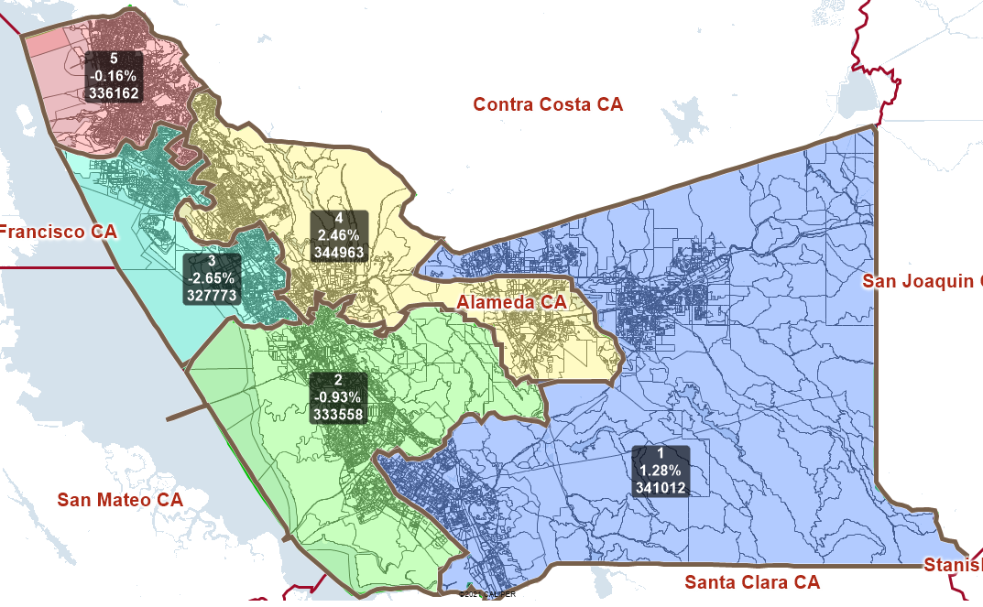
Ideal Population: 336,693.6
Total Deviation: 5.1%
Label:
District Number
Count of Population from Ideal
% of Population from Ideal

Slide 12
What are the mapping criteria?
FAIR MAPS ACT of 2019 (incorporating Alameda County Charter Criteria)
Criteria are Ranked in Order of Priority (“to the extent practicable”)
Compliance with US and CA Constitution (equal population)
Compliance with federal Voting Rights Act (race and language minorities)
Contiguity
Respect for (minimize division of) local neighborhoods and Communities of Interest (COIs)
COIs may not include relationships with political parties, incumbents, or political candidates.

Slide 13
What are the mapping criteria? (continued)
Criteria Ranked in Order of Priority (“to the extent practicable”)
Respect for (minimize division of) Cities and Census Designated Places
Boundaries should be easily identifiable and understandable by residents
Compactness: If it doesn’t conflict with preceding criteria
Do not favor or discriminate against political parties

Slide 14
What is a Section 2 or Majority/Minority District under the Voting Rights Act?
Gingles (Thornburg v. Gingles 1986) Criteria:
Minority group must be compact and large enough to constitute a majority in the district (50%+ CVAP*)
Minority group votes cohesively
There must be evidence of polarized voting against the minority group
*CVAP = Citizen Voting Age Population

Slide 15
QUESTIONS?
https://redistricting2021.acgov.org

Slide 16
For Reference: Redistricting Meeting Schedule
Board Meeting Date/Time | Action | Content
Tuesday 10/12 at 12pm | Hear a presentation and provide direction regarding what scenarios the consultant should explore and bring to the next meeting. | Overview of redistricting data, over/under map of the district population, Overview of COIs and public comments received so far. Preliminary Voting Rights Act review.
Tuesday 10/26 at 6pm | Select preliminary draft map(s) for further consideration | District mapping visualizations based on Board direction provided at the previous meeting. Review proposed maps received from the public. Review maps and make modifications live as directed by Board.
Tuesday 11/2 at 6pm (District meeting per AC Charter) | Review maps, hear from the public, provide direction to staff/consultant. | Overview of preliminary draft maps. Adjust map(s) as directed.

Slide 17
For Reference: Redistricting Meeting Schedule
Board Meeting Date/Time | Action | Content
Thursday 11/4 at 6pm (District meeting per AC Charter) | Review maps, hear from the public, narrow down maps for consideration, and provide direction to staff/consultant. | Overview of draft maps. Adjust map(s) as directed.
Tuesday 11/16 at 6pm (District meeting per AC Charter) | Review maps, hear from the public, narrow down (1-2) maps for consideration, and provide direction to staff/consultant. | Overview of draft maps. Adjust map(s) as directed.
Tuesday 11/23 at 6pm (District meeting per AC Charter) | Review maps, hear from the public, narrow down to a map for consideration, and provide direction to staff/consultant. | Overview of draft maps. Adjust map as directed.
Thursday 12/2 at 6pm (District meeting per AC Charter) | Review maps, hear from the public, and approve map for adoption | Overview of map. Make final map adjustments.
Tuesday, 12/7 at 12pm | First Reading of Ordinance | Overview of map and ordinance.
Tuesday, 12/14 at 12pm | Second Reading of Ordinance | Adopt Final Map

