Slide 1
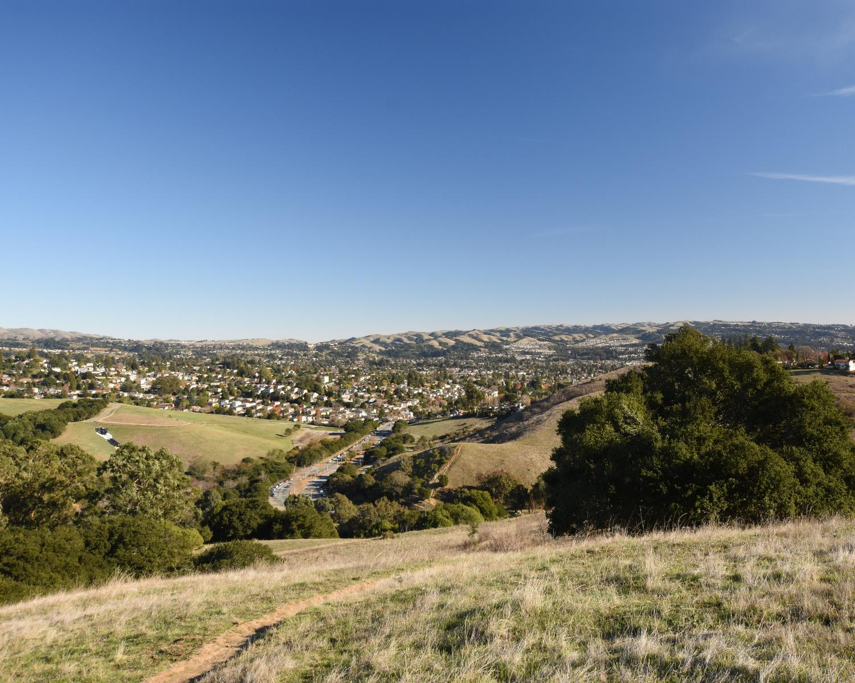

Karin Mac Donald
Q2 Data & Research, LLC
Alameda County Redistricting Consultant
Chris Bazar, Casey Farmer & Sandi Rivera
Community Development Agency
Alameda County
https://redistricting2021.acgov.org

Slide 2
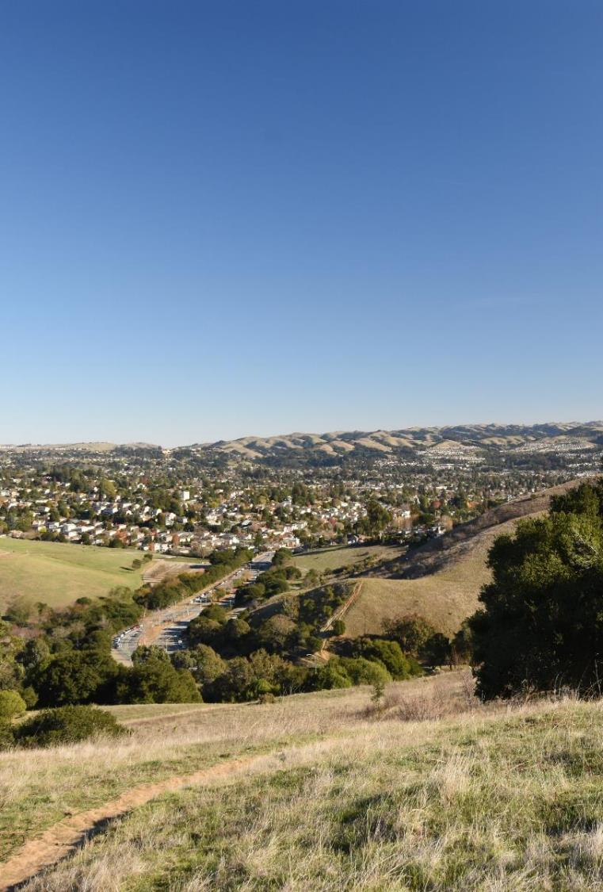
Overview
Introduction & Background
What is Redistricting?
Laws Governing Redistricting
Criteria for Redistricting
Outreach Activities to Date
Ways to Get Involved
Redistricting Process and Schedule

Slide 3
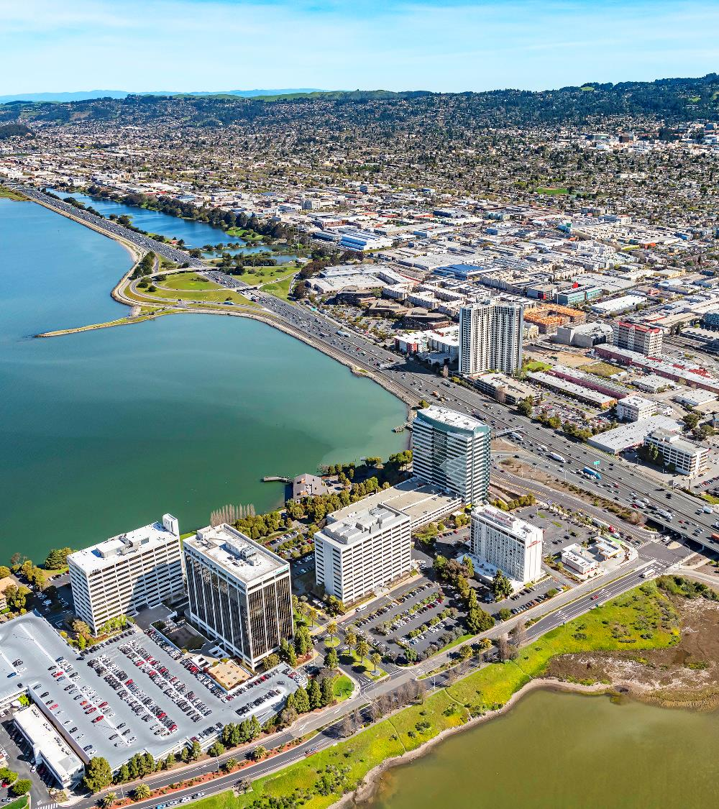
Background
The County of Alameda has 5 Board of Supervisor districts
Members of the County Board of Supervisors must live in their district to be eligible to represent it
Voters in each district elect the County Supervisor for their district

Slide 4

Districting versus Redistricting
Districting is the process of creating districts where there were none before
Redistricting is the process of adjusting the existing district boundaries
Redistricting usually happens every 10 years after the release of the decennial Census data
Decennial Census data are used to equalize the populations of the districts
Redistricting provides the opportunity to bring the existing districts into compliance with all redistricting criteria

Slide 5
Laws Governing Redistricting
U.S. and CA Constitutions
Federal Law
  Voting Rights Act
California Elections Code
Alameda County Charter and Administrative Code

Slide 6
FAIR MAPS Act - Overview
“Fair And Inclusive Redistricting for Municipalities And Political Subdivisions”
Addresses local redistricting for Cities and Counties
CA Elections Code Sections 21500 — 21509 address County Redistricting
Became law in October 2019
Creates a “state-mandated local program” and details the required processes for local redistricting

Slide 7
FAIR MAPS Act - The Process
The FAIR MAPS Act has strict timelines and requirements for the process
There are a minimum of 4 hearings that must take place before adopting the new district boundaries:
    At least 1 hearing must be held prior to creating a draft map
    A workshop led by staff or consultant may be held in lieu of 1 pre-draft hearing
    2 hearings must be held after creating a draft map
    A staff conducted workshop can substitute for one public hearing
Draft map(s) must be posted for feedback
There are specific timelines for posting Hearing Agendas and Drafts

Slide 8
County Charter and Administrative Code
The County Administrative Code requires additional hearings
Requires the Board, by a two-thirds vote, to effect any change to the boundaries of the supervisorial districts.
Administrative Code §2.04.030(B) requires 60 days notice prior to the first public hearing to approve redistricting maps
The Charter and Administrative Code provisions must be harmonized with State law requirements.

Slide 9
FAIR MAPS Act - Components of a Redistricting
Website
Public Hearings
Draft plan development
Posting requirements
Public Access (including applicable language Translations and Interpretation)
Public Input (oral, written or electronic)

Slide 10
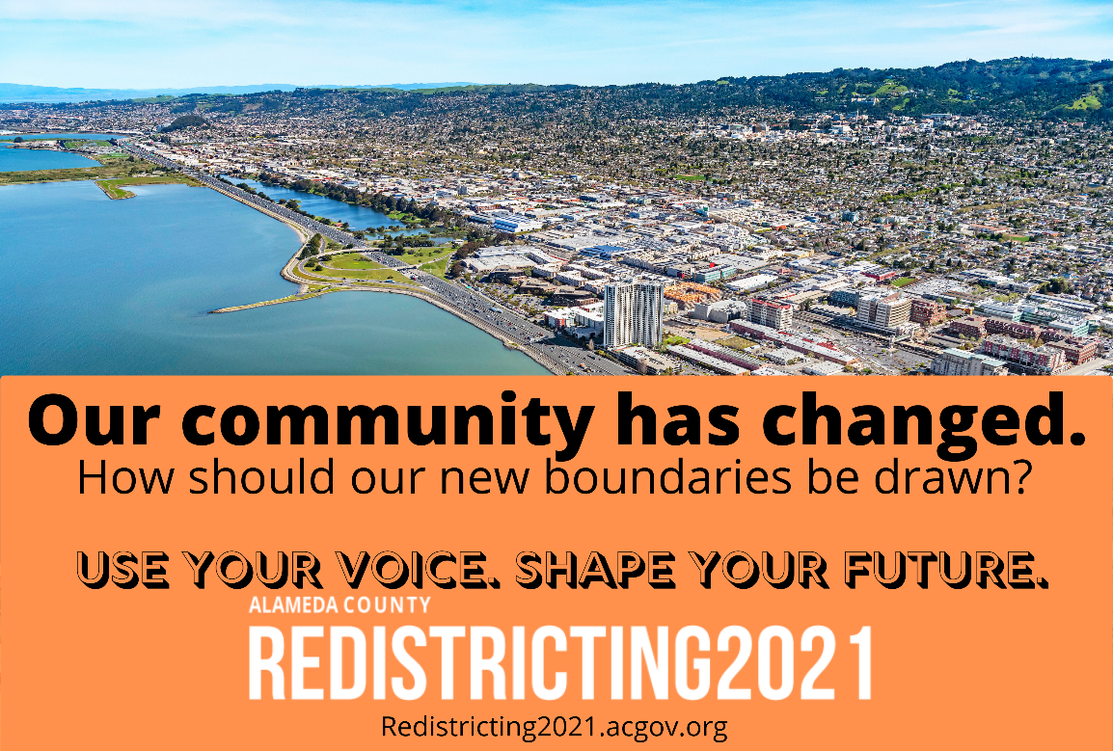
FAIR MAPS Act - Outreach and Education
Provide information to county media organizations, including media organizations that serve language minority communities.
Provide information through good government, civil rights, civic engagement, or community groups or organizations that are active in the county

Slide 11
FAIR MAPS Act - Public Input and Transparency
Meetings and Workshops:
Start at a set-time if combined with a regular or special meeting
Collect public input including on Communities of Interest
Provide live interpretation for non-English language speakers for certain languages
Meeting location accessible to people with disabilities

Slide 12
Census Data Delays
The Redistricting Cycle and all timelines were affected by the delay in the release of the Census Data
Census Data must be used to equalize the populations and meet Criterion 1 (US and CA Constitution – equal population)
The Census bureau released a “legacy” dataset on August 12, 2021 that necessitated reformatting
The State’s redistricting database released the reformatted data on August 18
The State’s official and complete redistricting database will be released on September 20, 2021
California law mandates that this dataset must be used in redistricting

Slide 13
The Project Website
Will remain live for 10 years
Will provide information about the date, time, and location for any public hearing or workshop five days before the hearing or workshop (or 3 days as we are closer to the final adoption date)
Will contain educational materials, handouts, presentations, videos or transcripts of hearings
Will contain mapping files, supporting documentation and associated demographic reports
Will include a district viewer where the Draft maps and any visualizations can be accessed
Will host the Draft(s) and Final District Maps

Slide 14

Video shared through partners, Alameda County communications platforms, and public access channels throughout the County.

Slide 15
Access Tools
The county made a free, online mapping application available that the public is using to define and submit their Communities of Interest.
An online mapping tool will allow members of the public to create district map proposals (available soon after data release)
Proposals developed with the online mapping tool can be submitted to the Board for consideration
The online mapping tool will allow users to view census geography and data for any area of interest within the County boundaries

Slide 16
What are the mapping criteria?
Criteria Ranked in Order of Priority (“to the extent practicable”)
Compliance with US and CA Constitution (equal population)
Compliance with federal Voting Rights Act (race and language minorities)
Geographic Contiguity
Geographic Integrity: respect (minimize division) of neighborhoods or local Communities of Interest (COIs)
    COIs may not include relationships with political parties, incumbents, or political candidates.

Slide 17
What are the mapping criteria? (continued)
Criteria Ranked in Order of Priority (“to the extent practicable”)
Geographic Integrity: respect (minimize division) Cities and Census Designated Places
Boundaries should be easily identifiable and understandable by residents
Compactness: If it doesn’t conflict with preceding criteria
Do not favor or discriminate against political parties

Slide 18
Alameda County Criteria
Alameda County Charter Section 7 lists similar criteria:
      Population
      Topography
      Geography
      Cohesiveness, contiguity, integrity, and compactness of territory
      Community of interests of the districts
An additional criterion is included in Administrative Code §2.04.030 – “that cities within a proposed district shall be maintained intact, insofar as possible.”

Slide 19
Workshop Trainings and More Information
There have been 2 extensive criteria and process workshop trainings to date
Those took place on July 24 and August 11
Videos of these trainings are available on our website https://redistricting2021.acgov.org/
The website contains all relevant information about how to participate, where and when the meetings and hearings are taking place, how to access the tools and how to reach the redistricting team.

Slide 20
Get Involved & Learn More
Thank you for participating!!!
To participate in the process:
Provide public comment, submit written comments, send supporting information to the County
Please provide information about your Community of Interest
Submit information at a workshop, meeting, or hearing, or:
  Visit our website’s Contact Us page to submit comments online.
  By Email at redistricting@acgov.org
  By Telephone (510.670.5333)
  By Written correspondence. Address to: Community Development Agency, Attn: Sandi Rivera, 224 W. Winton Ave., Rm 110, Hayward, CA 94544 throughout this redistricting process.
  Get information online and use our map interface at: https://redistricting2021.acgov.org/

Slide 21
Outreach Efforts to Date
Website launched in July https://redistricting2021.acgov.org/
2 Community Workshops: with nearly 100 attendees (in July and August)
1 Webinar: “Tips & Tools to Help Your Community Engage in Redistricting”
E-newsletter list of over 4,000 contacts
Promotional video released on September 1st
Partnership with the Alameda County Library to promote COI submissios
Multiple community events: Providing outreach materials and equipment

Slide 22
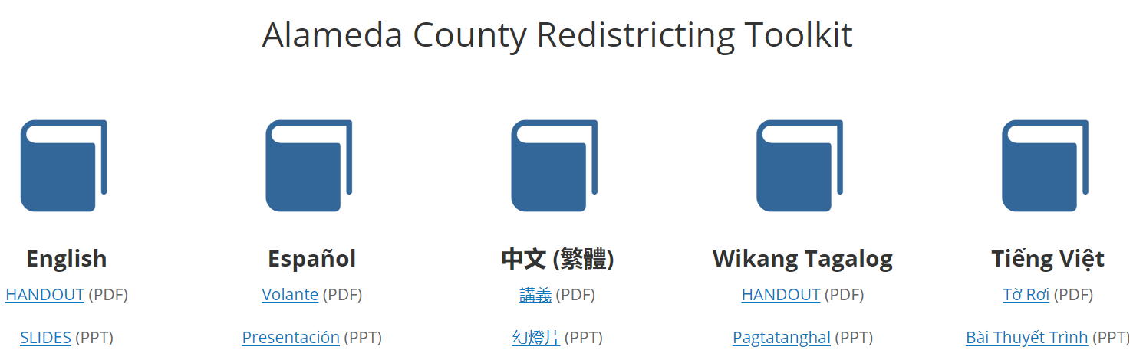
Outreach Efforts to Date (continued)
Redistricting Outreach Toolkit: Handout and Slides available in 5 languages
Local & ethic media: press releases & advertisements in progress
Staff presentations:
  Sunol, Eden, Fairview and Castro Valley Municipal Advisory Councils
  Alameda County Childcare Coordinating Council

Slide 23
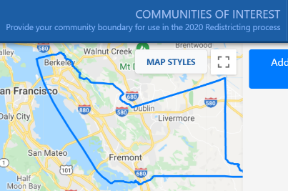
Public Input To Date
Method of Participation | Inputs as of 9/16/2021
“Community of Interest” Online Tool Submissions | 29
Written comments: Emails, comments on the webpage, or mailed in | 44 via website 15 via email
Proposed public maps | Online mapping program and redistricting data will be available starting October 1
Comments are also accepted via phone at (510) 670-5333

Slide 24
Redistricting Meeting Schedule
Board Meeting Date/Time | Action | Content
Tuesday 9/21 at 6pm | Hear a presentation and public comments. | Overview – new rules, criteria, process, outreach activities and schedule (similar to the presentation in April).
Tuesday 10/12 at 12pm | Hear a presentation and provide direction regarding what scenarios the consultant should explore and bring to the next meeting. | Overview of redistricting data, over/under map of the district population, Overview of COIs and public comments received so far. Preliminary Voting Rights Act review.
Tuesday 10/26 at 6pm | Select preliminary draft map(s) for further consideration | District mapping visualizations based on Board direction provided at the previous meeting. Review proposed maps received from the public. Review maps and make modifications live as directed by Board.
Tuesday 11/2 at 6pm (District meeting per AC Charter) | Review maps, hear from the public, provide direction to staff/consultant. | Overview of preliminary draft maps. Adjust map(s) as directed.

Slide 25
Redistricting Meeting Schedule
Board Meeting Date/Time | Action | Content
Thursday 11/4 at 6pm (District meeting per AC Charter) | Review maps, hear from the public, narrow down maps for consideration, and provide direction to staff/consultant. | Overview of draft maps. Adjust map(s) as directed.
Tuesday 11/16 at 6pm (District meeting per AC Charter) | Review maps, hear from the public, narrow down (1-2) maps for consideration, and provide direction to staff/consultant. | Overview of draft maps. Adjust map(s) as directed.
Tuesday 11/23 at 6pm (District meeting per AC Charter) | Review maps, hear from the public, narrow down to a map for consideration, and provide direction to staff/consultant. | Overview of draft maps. Adjust map as directed.
Thursday 12/2 at 6pm (District meeting per AC Charter) | Review maps, hear from the public, and approve map for adoption | Overview of map. Make final map adjustments.
Tuesday, 12/7 at 12pm | First Reading of Ordinance | Overview of map and ordinance.
Tuesday, 12/14 at 12pm | Second Reading of Ordinance | Adopt Final Map

Slide 26
QUESTIONS?
https://redistricting2021.acgov.org

