Slide 1
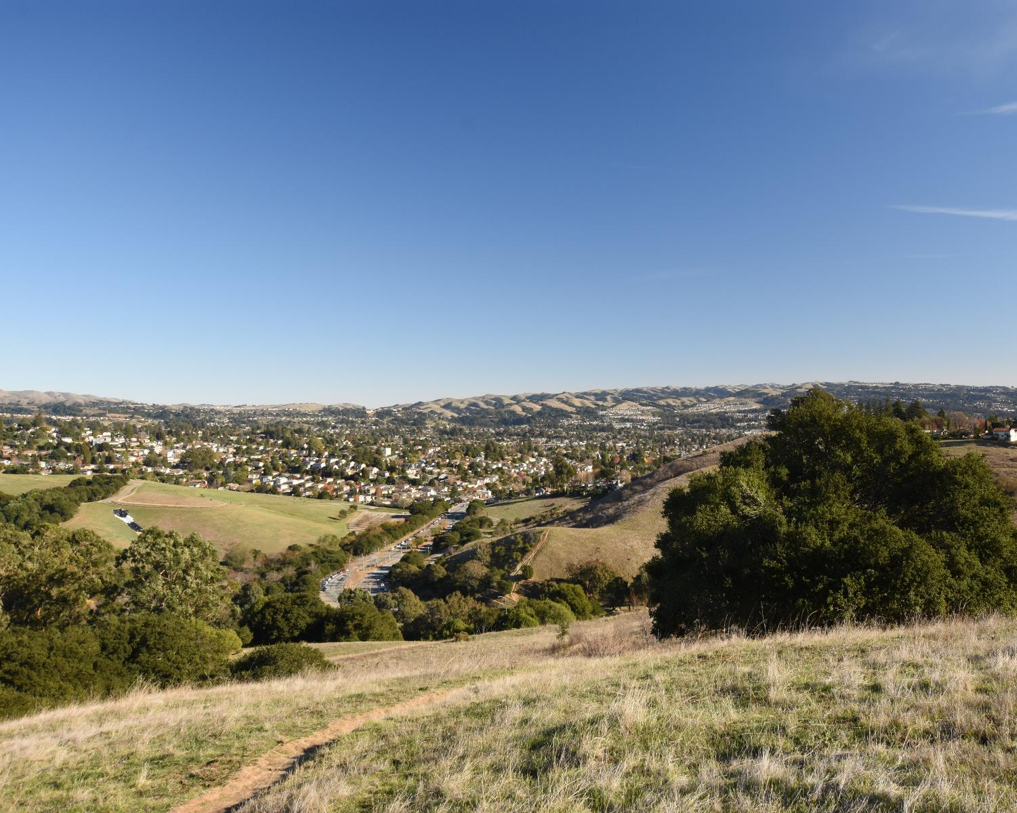

Public Hearing – November 16, 2021
District 5 Meeting
Karin Mac Donald & Kennedy Wilson
Q2 Data & Research, LLC Alameda County Redistricting Consultants
Chris Bazar, Casey Farmer & Sandi Rivera
Community Development Agency
Alameda County
https://redistricting2021.acgov.org

Slide 2
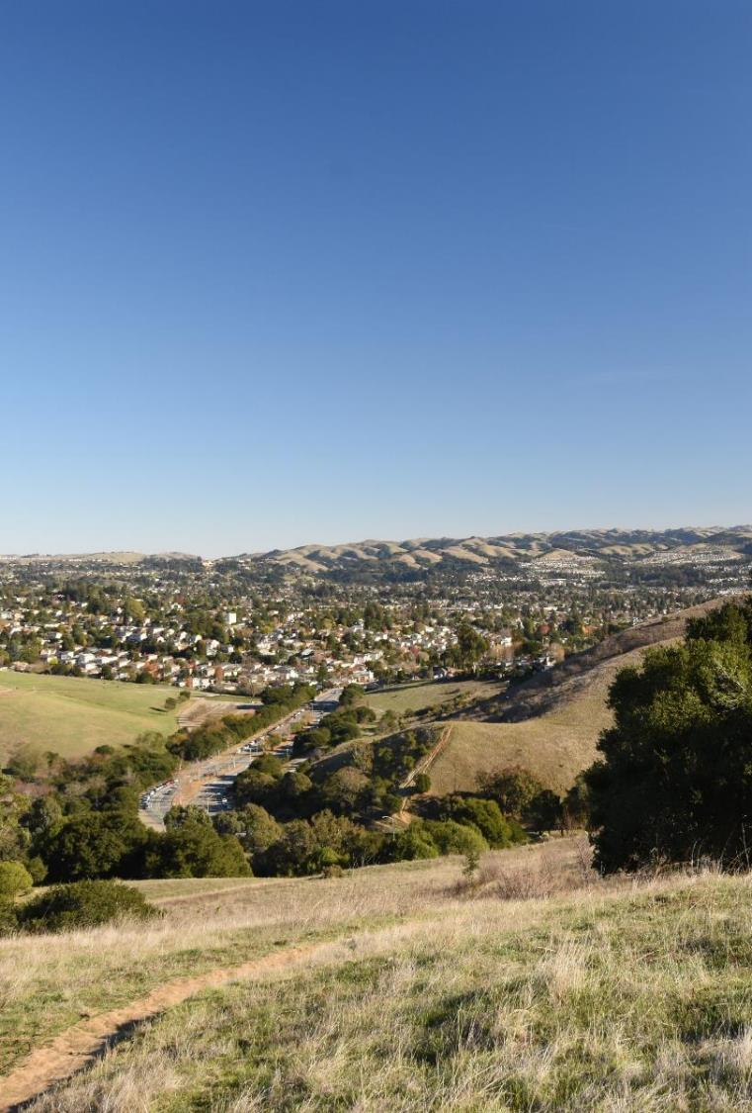
Outline
Outreach Activities
Mapping Criteria
Map visualizations and Community of Interest (COI) Overview
Board Receive Public Comments
Board to draw one or more maps
At least 2 public hearings must be held after the Board draws draft maps
A draft map must be published on the internet for 7 or 3 days (after 11/18) before adoption as a final map

Slide 3

Outreach Activities
Presentations:
Allen Temple Baptist Church Town Hall
Alameda County Public Information Officer Roundtable
Early Childhood Education State Contractors Meeting
Unity in the Community (San Leandro community-based organization)

Slide 4

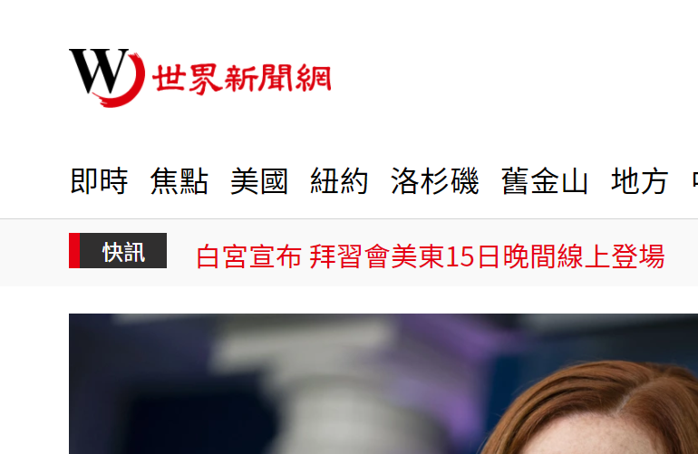



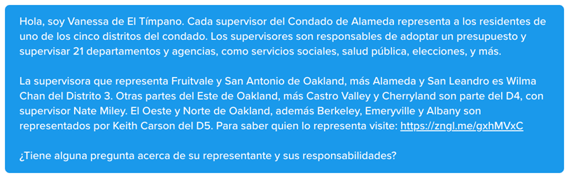
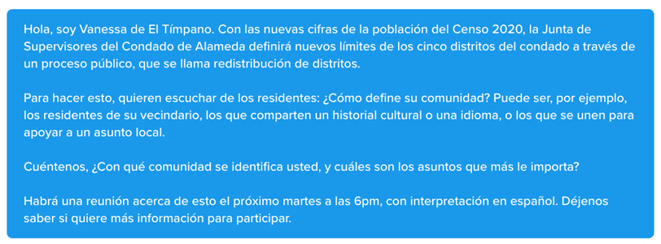

Ethnic Media
World Journal
El Tímpano Spanish information channel
KIQI 1010AM Spanish radio

Slide 5
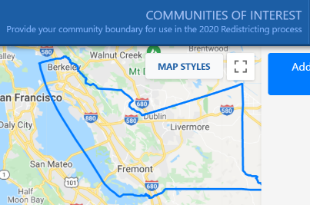
Public Input To Date
Method of Participation | Inputs as of 11/15/2021
“Community of Interest” Online Tool Submissions | 139
Written comments: Emails, comments on the webpage, or mailed in | 100
Proposed public maps Online mapping program launched on October 11 | 2
All public input is posted on Redistricting2021.acgov.org
Notes:
Casey to note outreach efforts. Summarize public input later.

Slide 6
What are the mapping criteria?
FAIR MAPS ACT of 2019 (incorporating Alameda County Charter Criteria)
Criteria are Ranked in Order of Priority (“to the extent practicable”)
Compliance with US and CA Constitution (equal population)
Compliance with federal Voting Rights Act (race and language minorities)
Contiguity
Respect for (minimize division of) local neighborhoods and Communities of Interest (COIs)
COIs may not include relationships with political parties, incumbents, or political candidates.

Slide 7
What are the mapping criteria? (continued)
Criteria Ranked in Order of Priority (“to the extent practicable”)
Respect for (minimize division of) Cities and Census Designated Places
Boundaries should be easily identifiable and understandable by residents
Compactness: If it doesn’t conflict with preceding criteria
Do not favor or discriminate against political parties

Slide 8
Map Visualizations and COI/Map Submittals Overview
(Change to live map presentation)
Visualizations are shown in subsequent slides for reference. The same information is provided in the live map presentation.

Slide 9
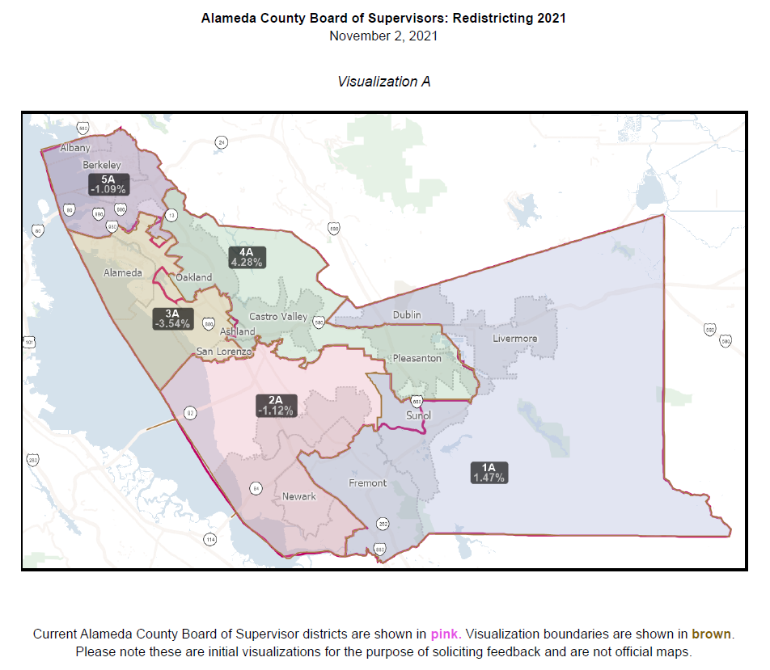
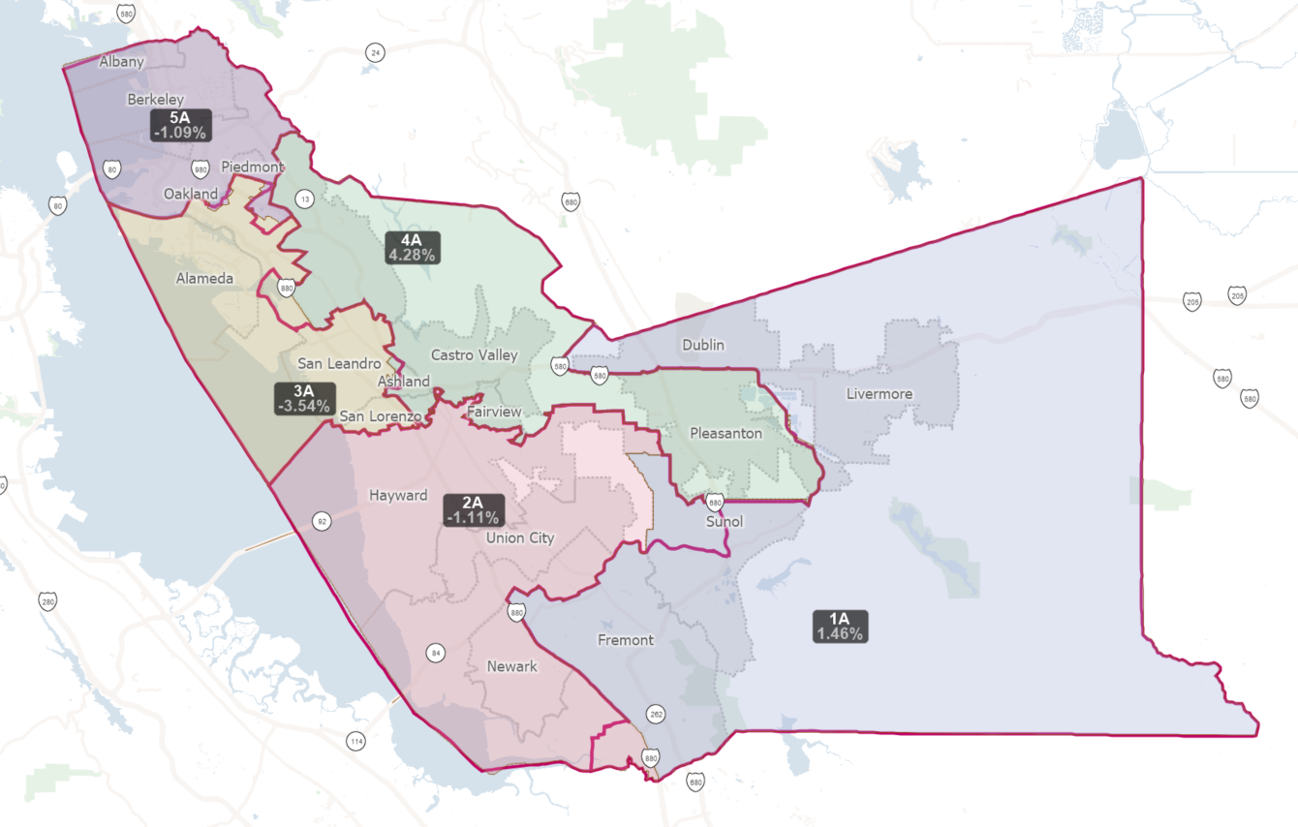
Map Visualizations

Slide 10
Visualization A
Makes minimal changes to current boundaries
Moved the D2 portion of Sunol into D1 to keep COI together
Moved Ashland into D4 to keep it together and to be with Cherryland, Fairview, and Castro Valley
Moved the east side of Lake Merritt into D5 to keep Lake Merritt Neighbors COI together
Moved the Glenview neighborhood into D5 to keep COI together
Moved 6 blocks from D5 to D3 to keep Oakland Chinatown COI together
Balanced population between D5 and D3
E22nd street moved up to E27th street; Foothill Blvd moved up to Brookdale Ave
Balanced population between D4 and D3
Moved everything West of 880 into D3 (next to Oakland Airport)
All other boundaries remain unchanged from current supervisorial districts. Oakland in 3 districts (D5, D4, & D3); Fremont in 2 districts (D1 & D2)

Slide 11
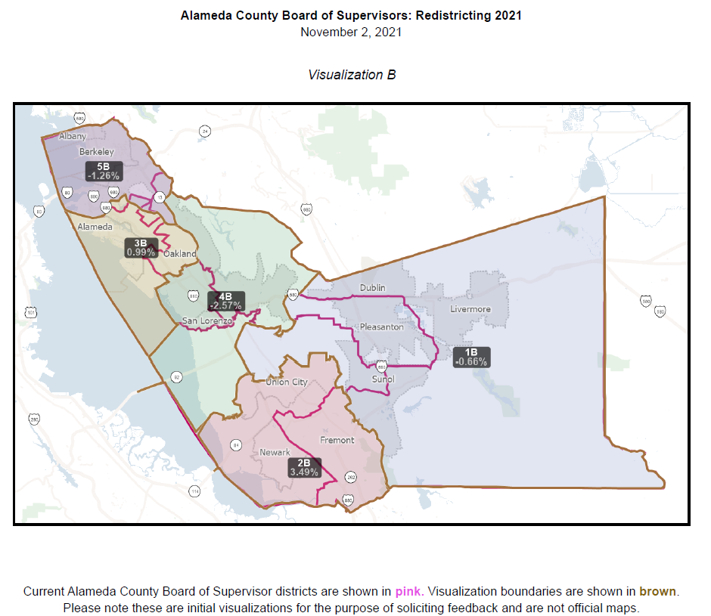
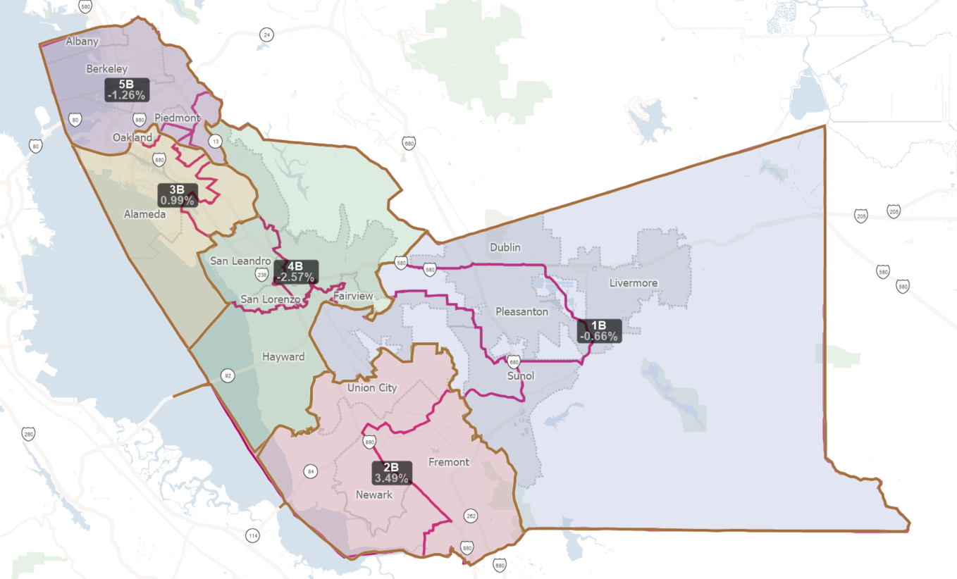
Map Visualizations

Slide 12
Visualization B
Keeps Tri-Valley COI together (Dublin, Pleasanton, Livermore) in D1
Keeps Sunol COI together
Hayward in 2 districts (D1 & D2) - splits along I-880 and Hwy 92 around CSUEB
Keeps Tri-cities together (Fremont, Union City, Newark) in D2
Follows city boundaries for Fremont and Union City
Oakland in 3 districts (D5, D4, & D3)
D3 includes all of Alameda, keeping it together with Oakland Chinatown, keeps this COI together
Keeps together Lake Merritt Neighbors COI, Oakland Chinatown COI, Downtown Oakland COI, Adams Point COI, and West Oakland COI
Keeps most of Fruitvale/Dimond COI together (excludes Upper Dimond neighborhood, keeps Lower Dimond)
Keeps together the Revived West Oakland COI, Lakeshore Homes Association COI, and Glenview COI in D5
Keeps unincorporated areas together (Castro Valley, Ashland, Cherryland, San Lorenzo, Fairview) in D4

Slide 13
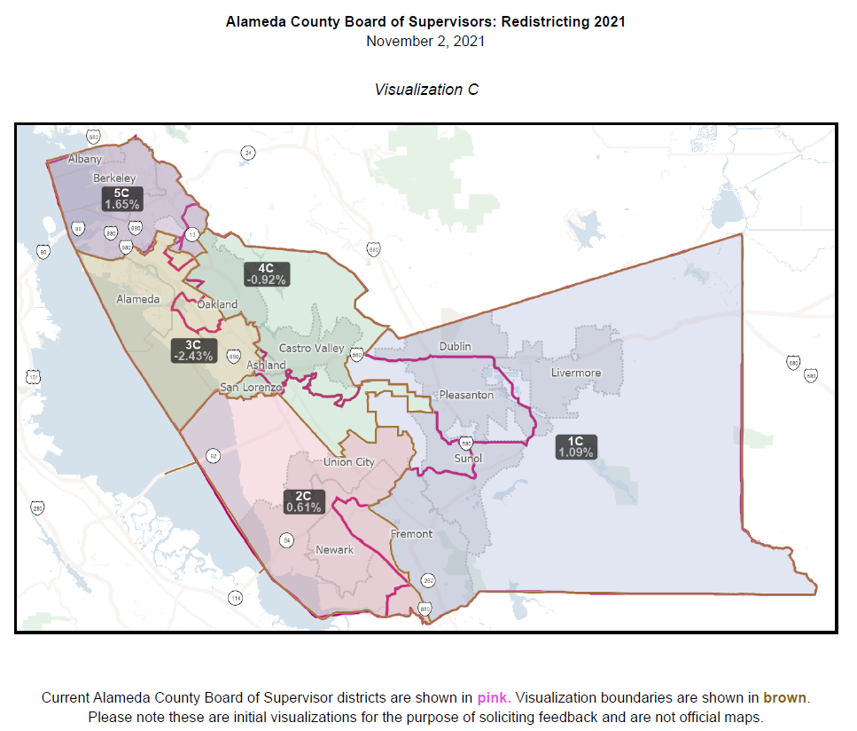
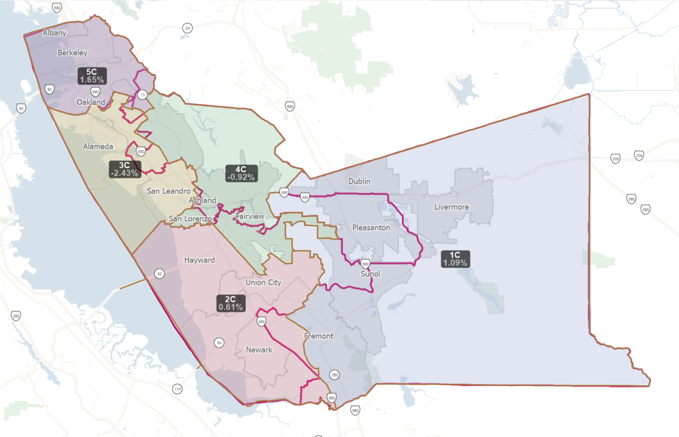
Map Visualizations

Slide 14
Visualization C
Keeps Tri-valley COI together (Dublin, Pleasanton, Livermore)
Keeps Sunol COI together
Fremont in 2 districts (D1 and D2) - splits along 880, Fremont Blvd, South Grimmer Blvd, Grimmer Blvd, Paseo Padre Parkway
Hayward in 2 districts (D2 and D4) - splits along the West Hayward COI, following the railroad tracks
Keeps the East Hayward COI together
Oakland in 3 districts (D3, D4, and D5)
Keeps together Oakland Chinatown COI and Lake Shore Homes Assocation COI
Splits Downtown Oakland COI
Glenview COI and Lake Merritt Neighbors COI are together in D5
Keeps Revived West Oakland COI
Urban unincorporated COIs kept together: Castro Valley, Fairview, San Lorenzo, Cherryland, and Ashland

Slide 15
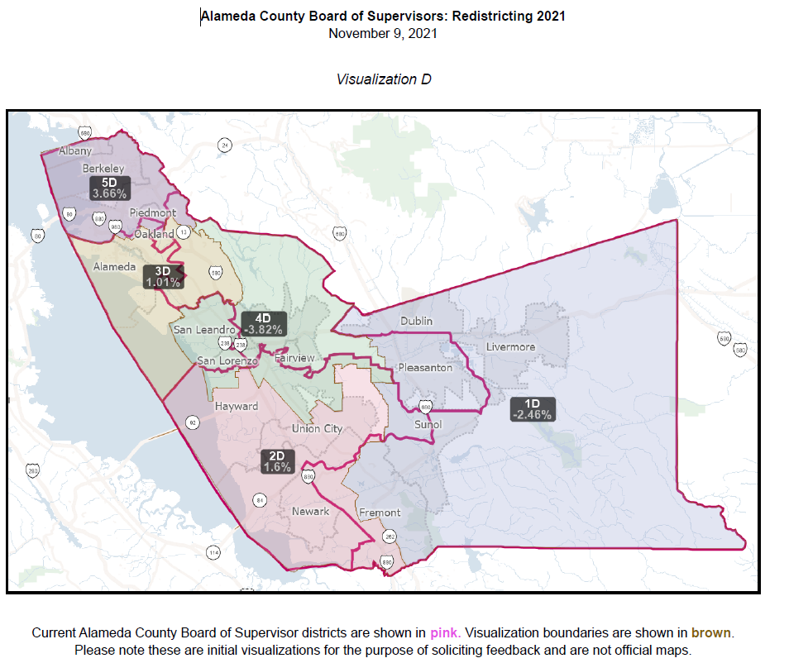
Map Visualizations

Slide 16
Visualization D
Oakland in 2 districts (D3 and D5)
Keeps Lake Merritt Neighbors, Glenview, Lakeshore Home Assoc., and Adams Point COIs together
Keeps Fruitvale/Dimond District COI together
Keeps Tri-Valley COI together (Dublin, Pleasanton, Livermore)
Keeps Sunol COI together
Fremont in 2 districts (D1 and D2) - splits along 680, Auto Mall Parkway, Grimmer Blvd, Fremont Blvd, Mowry Ave, Orchard Drive, north of Timpanogas Circle, west of Old Canyon Road.
Keeps the CAIR Centerville COI together in Fremont
Hayward in 2 districts (D2 and D4) - splits along the railway tracks, West Jackson Street, and 880; and, in the north along the San Lorenzo Unified School District boundary
Urban unincorporated COIs kept together: Castro Valley, Fairview, San Lorenzo, Cherryland, and Ashland
Keeps San Lorenzo Unified School District together

Slide 17
QUESTIONS?
https://redistricting2021.acgov.org

Slide 18
For Reference: Redistricting Meeting Schedule
Board Meeting Date/Time | Action | Content
Tuesday 10/12 at 12pm | Hear a presentation and provide direction regarding what scenarios the consultant should explore and bring to the next meeting. | Overview of redistricting data, over/under map of the district population, Overview of COIs and public comments received so far. Preliminary Voting Rights Act review.
Tuesday 10/26 at 6pm | Select preliminary draft map(s) for further consideration | District mapping visualizations based on Board direction provided at the previous meeting. Review proposed maps received from the public. Review maps and make modifications live as directed by Board.
Tuesday 11/2 at 6pm (District meeting per AC Charter – District 1) | Review maps, hear from the public, provide direction to staff/consultant. | Overview of preliminary draft maps. Adjust map(s) as directed.

Slide 19
For Reference: Redistricting Meeting Schedule
Board Meeting Date/Time | Action | Content
Thursday 11/4 at 6pm (District meeting per AC Charter – District 2) | Review maps, hear from the public, narrow down maps for consideration, and provide direction to staff/consultant. | Overview of draft maps. Adjust map(s) as directed.
Tuesday 11/16 at 6pm (District meeting per AC Charter – District 5) | Review maps, hear from the public, narrow down (1-2) maps for consideration, and provide direction to staff/consultant. | Overview of draft maps. Adjust map(s) as directed.
Tuesday 11/23 at 6pm (District meeting per AC Charter – District 4) | Review maps, hear from the public, narrow down to a map for consideration, and provide direction to staff/consultant. | Overview of draft maps. Adjust map as directed.
Thursday 12/2 at 6pm (District meeting per AC Charter – District 3) | Review maps, hear from the public, and approve map for adoption | Overview of map. Make final map adjustments.
Tuesday, 12/7 at 12pm | First Reading of Ordinance | Overview of map and ordinance.
Tuesday, 12/14 at 12pm | Second Reading of Ordinance | Adopt Final Map

