Slide 1
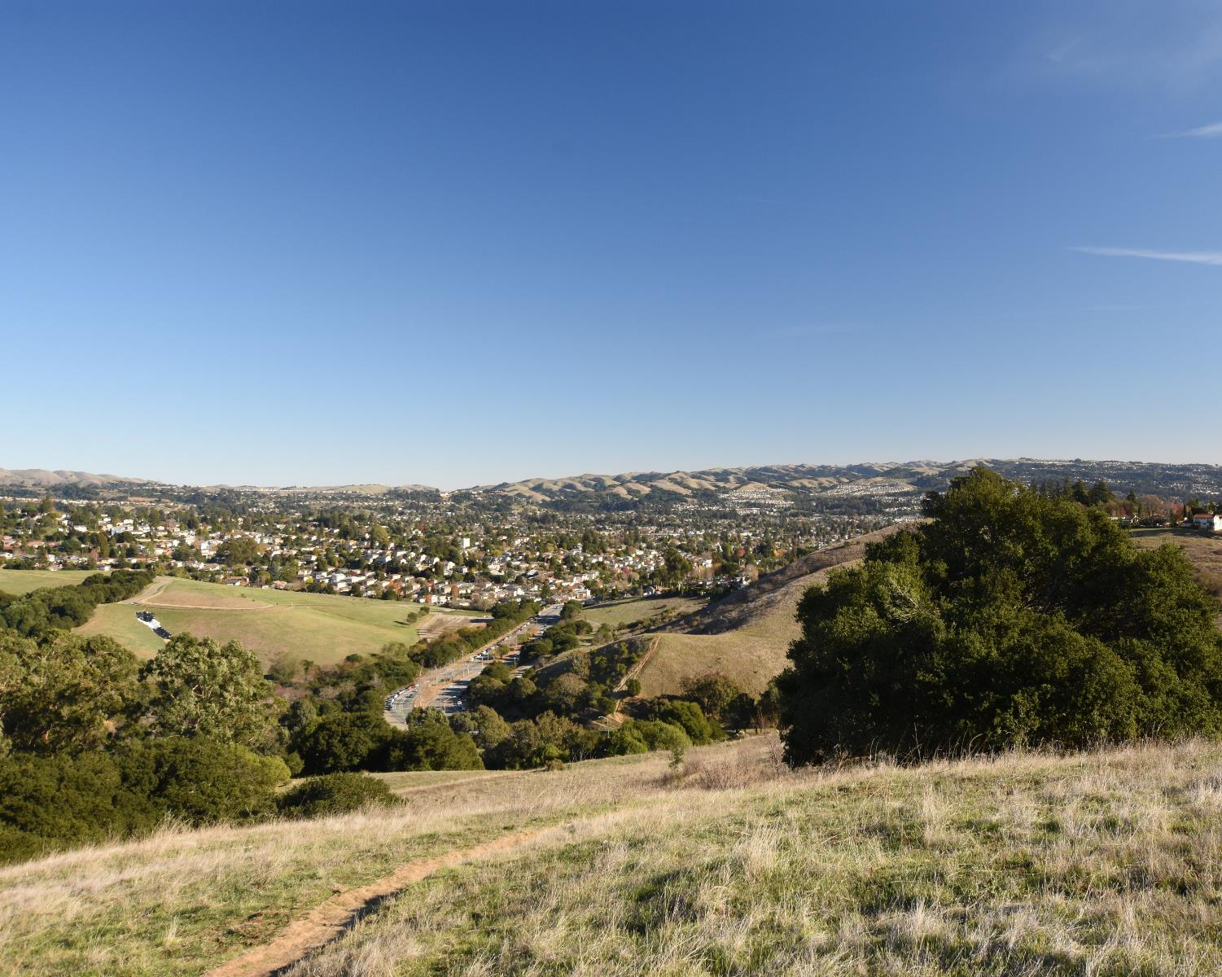

Public Hearing – November 23, 2021
District 4 Meeting
Karin Mac Donald & Jane Hood
Q2 Data & Research, LLC Alameda County Redistricting Consultants
Chris Bazar, Casey Farmer & Sandi Rivera
Community Development Agency
Alameda County
https://redistricting2021.acgov.org

Slide 2
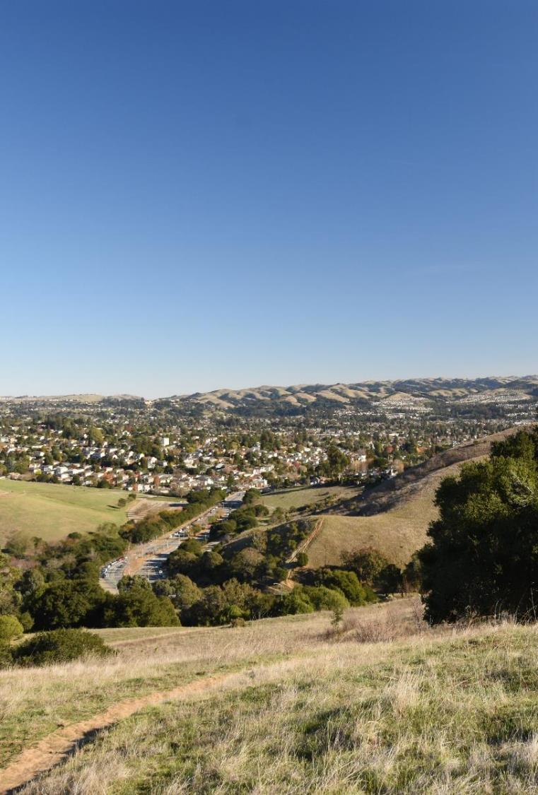
Outline
Outreach Activities
Mapping Criteria
Draft Map and Community of Interest (COI) Overview
Board Receive Public Comments
Provide direction to consultant and staff on draft map modifications

Slide 3
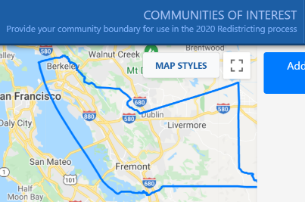
Public Input To Date
Method of Participation | Inputs as of 11/22/2021
“Community of Interest” Online Tool Submissions | 145
Written comments: Emails, comments on the webpage, or mailed in | 128
Proposed public maps Online mapping program launched on October 11 | 2
All public input is posted on Redistricting2021.acgov.org
Notes:
Casey to note outreach efforts. Summarize public input later.

Slide 4

What are the mapping criteria?
FAIR MAPS ACT of 2019 (incorporating Alameda County Charter Criteria)
Criteria are Ranked in Order of Priority (“to the extent practicable”)
Compliance with US and CA Constitution (equal population)
Compliance with federal Voting Rights Act (race and language minorities)
Contiguity
Respect for (minimize division of) local neighborhoods and Communities of Interest (COIs)
COIs may not include relationships with political parties, incumbents, or political candidates.

Slide 5
What are the mapping criteria? (continued)
Criteria Ranked in Order of Priority (“to the extent practicable”)
Respect for (minimize division of) Cities and Census Designated Places
Boundaries should be easily identifiable and understandable by residents
Compactness: If it doesn’t conflict with preceding criteria
Do not favor or discriminate against political parties

Slide 6
Draft Map and COI/Map Submittals Overview
(Change to live map presentation)

Slide 7
Draft Map A
Draft Map A
Current Alameda County Board of Supervisor districts are shown in pink.
Draft Map A boundaries are shown in brown and shown with colors and labels.
November 18, 2021

Slide 8
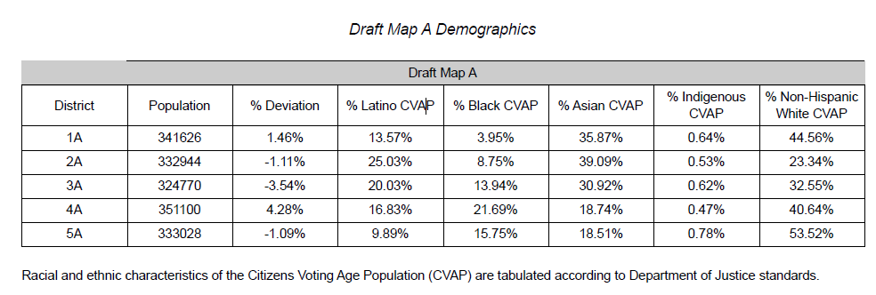
Draft Map A - Demographics

Slide 9
QUESTIONS?
https://redistricting2021.acgov.org

Slide 10
For Reference: Redistricting Meeting Schedule
Board Meeting Date/Time | Action | Content
Tuesday 11/23 at 6pm (District meeting per Admin Code – District 4) | Review maps, hear from the public, narrow down to a map for consideration, and provide direction to staff/consultant. | Overview of draft maps. Adjust map as directed.
Thursday 12/2 at 6pm (District meeting per Admin Code – District 3) | Review maps, hear from the public, and approve map for adoption | Overview of map. Make final map adjustments.
Tuesday, 12/7 at 12pm | First Reading of Ordinance | Overview of map and ordinance.
Tuesday, 12/14 at 12pm | Second Reading of Ordinance | Adopt Final Map

