Slide 1
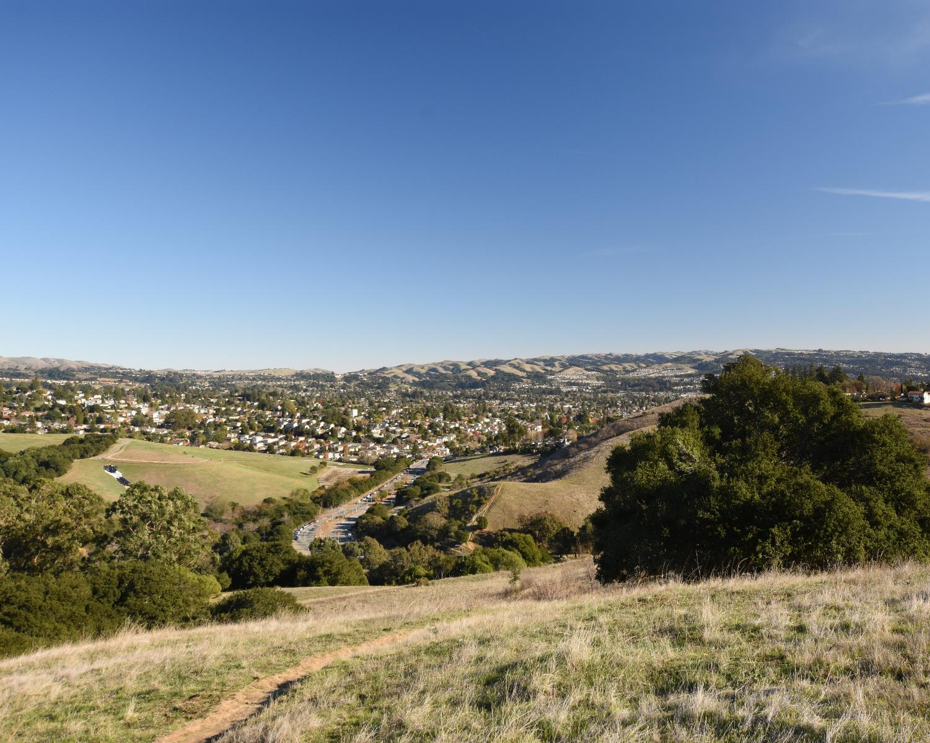

Public Hearing – November 4, 2021
District 2 Meeting
Jane Hood & Karin Mac Donald
Q2 Data & Research, LLC Alameda County Redistricting Consultants
Chris Bazar, Casey Farmer & Sandi Rivera
Community Development Agency
Alameda County
https://redistricting2021.acgov.org

Slide 2
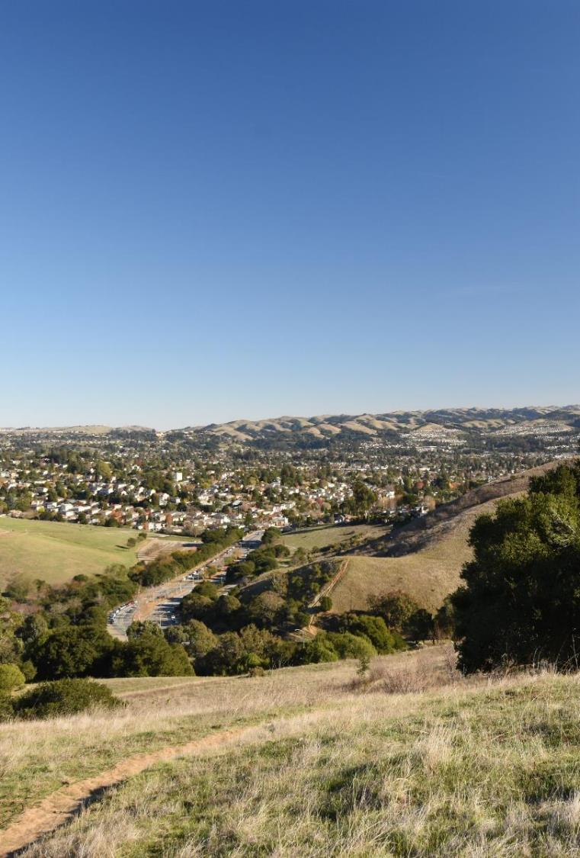
Outline
Outreach Activities
Mapping Criteria
Map visualizations and Community of Interest (COI) Overview
Board Receive Public Comments
Provide direction to consultant and staff on scenarios for the next Board meeting

Slide 3
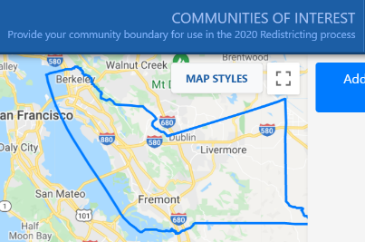
Public Input To Date
Method of Participation | Inputs as of 11/3/2021
“Community of Interest” Online Tool Submissions | 132
Written comments: Emails, comments on the webpage, or mailed in | 69
Proposed public maps Online mapping program launched on October 11 | 2
All public input is posted on Redistricting2021.acgov.org
Notes:
Casey to note outreach efforts. Summarize public input later.

Slide 4

What are the mapping criteria?
FAIR MAPS ACT of 2019 (incorporating Alameda County Charter Criteria)
Criteria are Ranked in Order of Priority (“to the extent practicable”)
Compliance with US and CA Constitution (equal population)
Compliance with federal Voting Rights Act (race and language minorities)
Contiguity
Respect for (minimize division of) local neighborhoods and Communities of Interest (COIs)
COIs may not include relationships with political parties, incumbents, or political candidates.

Slide 5
What are the mapping criteria? (continued)
Criteria Ranked in Order of Priority (“to the extent practicable”)
Respect for (minimize division of) Cities and Census Designated Places
Boundaries should be easily identifiable and understandable by residents
Compactness: If it doesn’t conflict with preceding criteria
Do not favor or discriminate against political parties

Slide 6
COI Submittals Overview and Map Visualizations
Map visualization that makes minor alterations to the existing lines, respects as many of the submitted COIs as possible, and follows the FAIR Maps Act criteria.
Map visualization that makes major alterations to the existing lines and uses the submitted COIs along with other FAIR Maps Act criteria, incorporating as many COIs as possible.
(Change to map presentation)

Slide 7
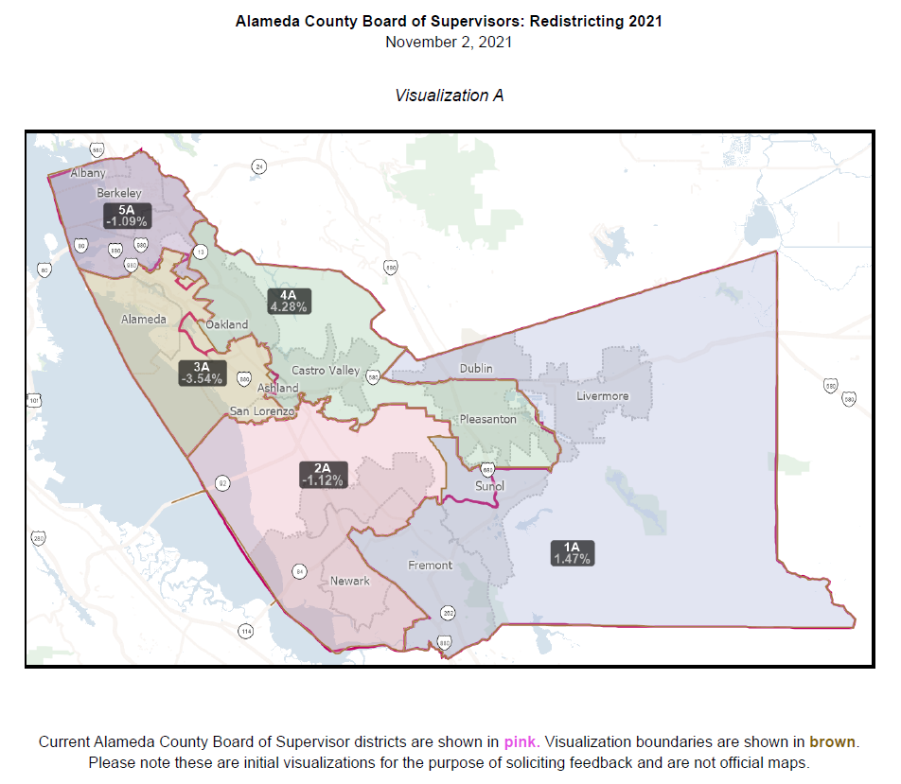
Map Visualizations

Slide 8
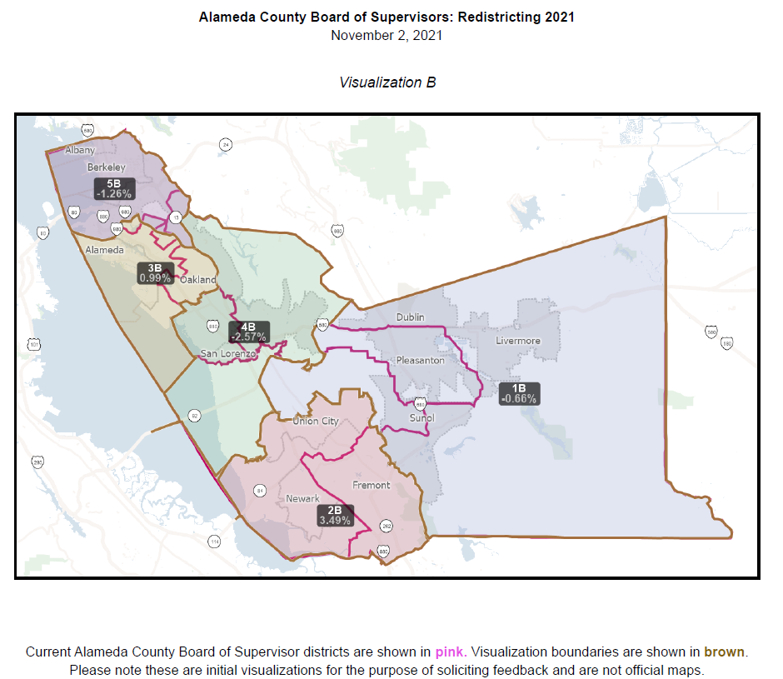
Map Visualizations

Slide 9
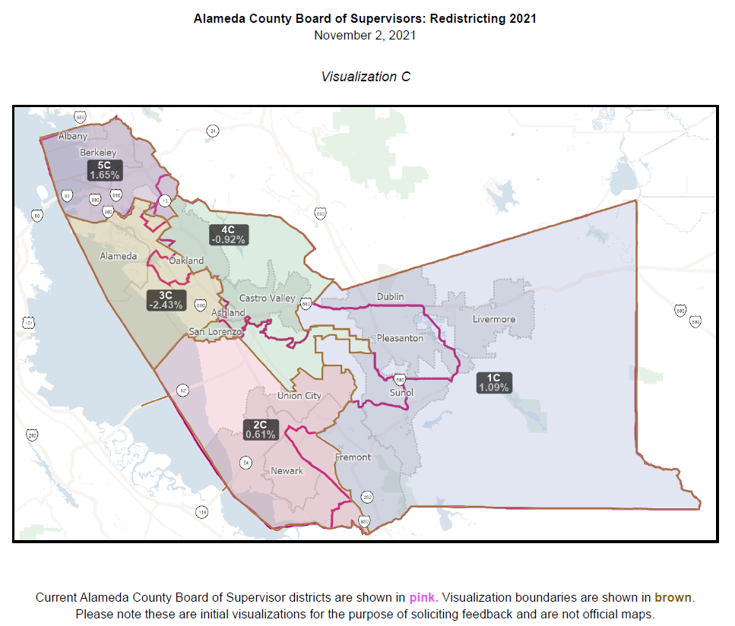
Map Visualizations

Slide 10
QUESTIONS?
https://redistricting2021.acgov.org

Slide 11
For Reference: Redistricting Meeting Schedule
Board Meeting Date/Time | Action | Content
Tuesday 10/12 at 12pm | Hear a presentation and provide direction regarding what scenarios the consultant should explore and bring to the next meeting. | Overview of redistricting data, over/under map of the district population, Overview of COIs and public comments received so far. Preliminary Voting Rights Act review.
Tuesday 10/26 at 6pm | Select preliminary draft map(s) for further consideration | District mapping visualizations based on Board direction provided at the previous meeting. Review proposed maps received from the public. Review maps and make modifications live as directed by Board.
Tuesday 11/2 at 6pm (District meeting per AC Charter – District 1) | Review maps, hear from the public, provide direction to staff/consultant. | Overview of preliminary draft maps. Adjust map(s) as directed.

Slide 12
For Reference: Redistricting Meeting Schedule
Board Meeting Date/Time | Action | Content
Thursday 11/4 at 6pm (District meeting per AC Charter – District 2) | Review maps, hear from the public, narrow down maps for consideration, and provide direction to staff/consultant. | Overview of draft maps. Adjust map(s) as directed.
Tuesday 11/16 at 6pm (District meeting per AC Charter – District 5) | Review maps, hear from the public, narrow down (1-2) maps for consideration, and provide direction to staff/consultant. | Overview of draft maps. Adjust map(s) as directed.
Tuesday 11/23 at 6pm (District meeting per AC Charter – District 4) | Review maps, hear from the public, narrow down to a map for consideration, and provide direction to staff/consultant. | Overview of draft maps. Adjust map as directed.
Thursday 12/2 at 6pm (District meeting per AC Charter – District 3) | Review maps, hear from the public, and approve map for adoption | Overview of map. Make final map adjustments.
Tuesday, 12/7 at 12pm | First Reading of Ordinance | Overview of map and ordinance.
Tuesday, 12/14 at 12pm | Second Reading of Ordinance | Adopt Final Map

